Slide 1
UNIT I INTRODUCTION TO ALGORITM DESIGN
Session - 3

Slide 2
Algorithm Analysis
An algorithm is said to be efficient and fast,
if it takes less time to execute
consumes less memory space.
The performance of an algorithm is measured on the basis of
Time Complexity
Space Complexity

Slide 3
Space Complexity
The amount of memory space required by the algorithm in its life cycle.
A fixed part For example simple variables & constant used and program size etc.
A variable part For example dynamic memory allocation, recursion stacks space etc.
Space complexity S(P) of any algorithm P is
S(P) = C + SP(I)
Where C is the fixed part
S(I) is the variable part of the algorithm

Slide 4
Time Complexity - T(n)
The amount of time required by the algorithm to run to completion.
T(n) can be measured as the number of steps, provided each step consumes constant time.

Slide 5
Algorithm analysis
The worst-case complexity of the algorithm is the function defined by the maximum number of steps taken on any instance of size n.
The best-case complexity of the algorithm is the function defined by the minimum number of steps taken on any instance of size n.
Finally, the average-case complexity of the algorithm is the function defined by the average number of steps taken on any instance of size n.

Slide 6
Mathematical Analysis
For Non-recursive Algorithms
There are four rules to count the operations:
Rule 1: for loops - the size of the loop times the running time of the body
Find the running time of statements when executed only once
Find how many times each statement is executed
Rule 2 : Nested loops
The product of the size of the loops times the running time of the body
Rule 3: Consecutive program fragments
The total running time is the maximum of the running time of the individual fragments
Rule 4: If statement
The running time is the maximum of the running times of if stmt and else stmt.

Slide 7

Rule 1: for loops
for( i = 0; i < n; i++) // i = 0; executed only once: O(1)
// i < n; n + 1 times O(n)
// i++ n times O(n)
// total time of the loop heading:
// O(1) + O(n) + O(n) = O(n)
sum = sum + i; // executed n times, O(n)
The loop heading plus the loop body will give: O(n) + O(n) = O(n).
IF
The size of the loop is n (loop variable runs from 0, or some fixed constant, to n)
The body has constant running time (no nested loops)
Loop running time is: O(n)

Slide 8
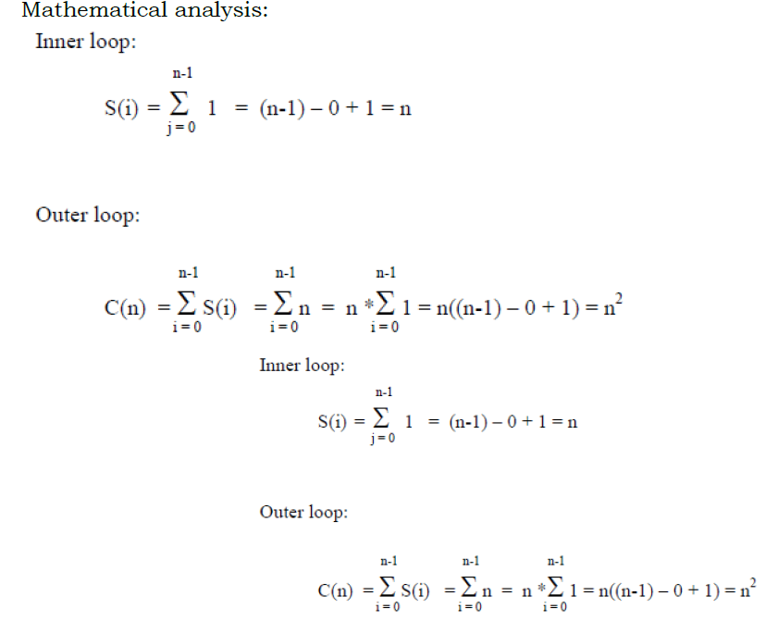
Rule 2 : Nested loops
sum = 0;
for( i = 0; i < n; i++)
for( j = 0; j < n; j++)
sum++;
Applying Rule 1 for the nested loop (the ‘j’ loop) we get O(n) for the body of the outer loop. The outer loop runs n times, therefore the total time for the nested loops will be O(n) * O(n) = O(n*n) = O(n^2)

Slide 9
for( i = 0; i < n; i++)
for( j = i; j < n; j++)
sum++;
Here, the number of the times the inner loop is executed depends on the value of i
i = 0, inner loop runs n times
i = 1, inner loop runs (n-1) times
i = 2, inner loop runs (n-2) times
…
i = n – 2, inner loop runs 2 times
i = n – 1, inner loop runs once.
Thus we get: ( 1 + 2 + … + n) = n*(n+1)/2 = O(n^2)
Running time is the product of the size of the loops times the running time of the body.

Slide 10
Rule 3: Consecutive program fragment
sum = 0;
for( i = 0; i < n; i++)
sum = sum + i;
sum = 0;
for( i = 0; i < n; i++)
for( j = 0; j < 2*n; j++)
sum++;
The first loop runs in O(n) time, the second - O(n^2) time, the maximum is O(n^2)
The total running time is the maximum of the running time of the individual fragments

Slide 11
Rule 4: If statement
if C
S1;
else
S2;
The running time is the maximum of the running times of S1 and S2.
The running time is the maximum of the running times of if stmt and else stmt

Slide 12
Exercise
a.
sum = 0;
for( i = 0; i < n; i++)
for( j = 0; j < n * n; j++)
sum++;
Ans : O(n^3)
b.
sum = 0;
for( i = 0; i < n; i++)
for( j = 0; j < i; j++)
sum++;
Ans : O(n^2)
c.
sum = 0;
for( i = 0; i < n; i++)
for( j = 0; j < i*i; j++)
for( k = 0; k < j; k++)
sum++;
Ans : O(n^5)
d.
sum = 0;
for( i = 0; i < n; i++)
sum++;
val = 1;
for( j = 0; j < n*n; j++)
val = val * j;
Ans : O(n^2)

Slide 13
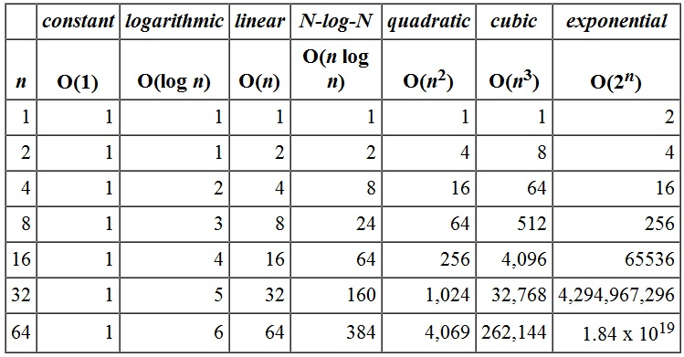
Order of Growth Function

Slide 14
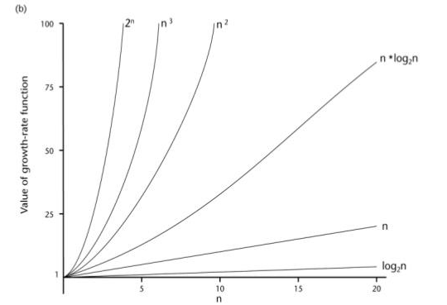

Slide 15
Linear Search Analysis
linear(a[n], key)
for( i = 0; i < n; i++)
if (a[i] == key)
return i;
else return -1;
Worst Case : O(n) // Rule 1 for loop explanation
Average Case :
If the key is in the first array position: 1 comparison
If the key is in the second array position: 2 comparisons
...
If the key is in the ith postion : i comparisons
...
So average all these possibilities: (1+2+3+...+n)/n = [n(n+1)/2] /n = (n+1)/2 comparisons.
The average number of comparisons is (n+1)/2 = Θ(n).
Best Case : O(1)

Slide 16
Binary Search Analysis
binarysearch(a[n], key, low, high)
while(low<high)
{
mid = (low+high)/2;
if(a[mid]=key)
return mid;
elseif (a[mid] > key)
high=mid-1;
else
low=mid+1;
}
return -1;

Slide 17
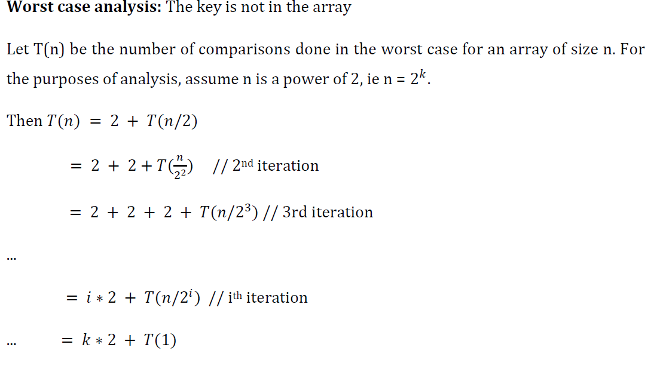
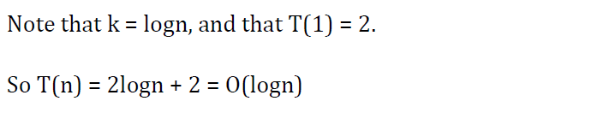

Slide 18
Bubble sort analysis
int i, j, temp;
for(i=0; i<n; i++)
{
for(j=0; j<n-i-1; j++)
{
if( a[j] > a[j+1])
{
temp = a[j];
a[j] = a[j+1];
a[j+1] = temp;
}
}
}

Slide 19
Worst Case: In Bubble Sort, n-1 comparisons will be done in 1st pass, n-2 in 2nd pass, n-3 in 3rd pass and so on. So the total number of comparisons will be
(n-1)+(n-2)+(n-3)+.....+3+2+1
Sum = n(n-1)/2
Hence the complexity of Bubble Sort is O(n²).
Best-case Time Complexity will be O(n), it is when the list is already sorted.

Slide 20
Insertion Sorting Analysis
int i, j, key;
for(i=1; i<n; i++)
{
key = a[i];
j = i-1;
while(j>=0 && key < a[j])
{
a[j+1] = a[j];
j--;
}
a[j+1] = key;
}
Worst Case Time Complexity : O(n^2)
Best Case Time Complexity : O(n)
Average Time Complexity : O(n^2)

